Slide 1
Requirements engineering

Slide 2
Requirements Engineering
The requirements for a system are the descriptions of what the system should do
The process of finding out, analyzing, documenting and checking these services and constraints is called Requirements Engineering (RE).

Slide 3
Requirements Engineering
The term ‘requirement’ is not used consistently in the software industry.
In some cases, a requirement is simply a high-level, abstract statement of a service that a system should provide or a constraint on a system.
At the other extreme, it is a detailed, formal definition of a system function.

Slide 4
SRS=User Requirements + System Requirement
User requirements are statements, in a natural language plus diagrams, of what services the system is expected to provide to system users and the constraints under which it must operate.
System requirements are more detailed descriptions of the software system’s functions, services, and operational constraints. The system requirements document (sometimes called a functional specification) should define exactly what is to be implemented. It may be part of the contract between the system buyer and the software developers.

Slide 5
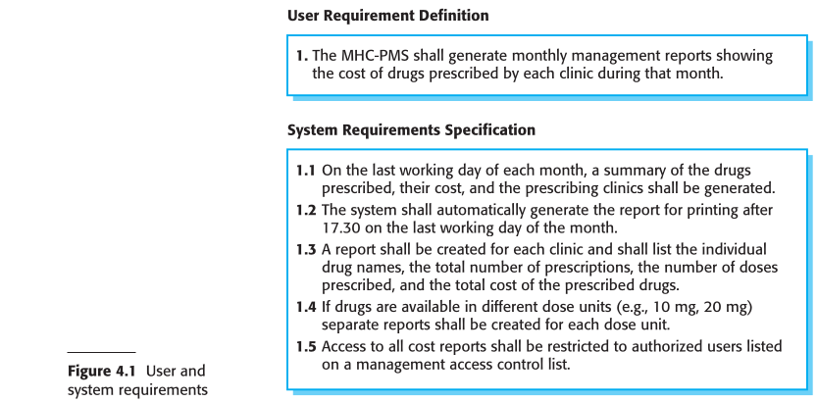

Slide 6
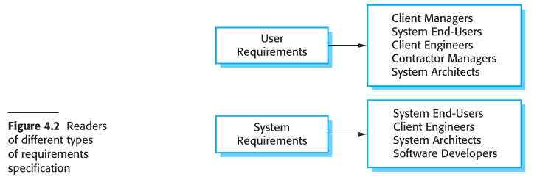

Slide 7
Functional & Non-functional requirements
Functional requirements These are statements of services the system should provide, how the system should react to particular inputs, and how the system should behave in particular situations. In some cases, the functional requirements may also explicitly state what the system should not do.
Non-functional requirements These are constraints on the services or functions offered by the system. They include timing constraints, constraints on the devel opment process, and constraints imposed by standards. Non-functional requirements often apply to the system as a whole, rather than individual system features or services.

Slide 8
Example of Functional requirements
A user shall be able to search the appointments lists for all clinics.
The system shall generate each day, for each clinic, a list of patients who are expected to attend appointments that day.
Each staff member using the system shall be uniquely identified by his or her eight-digit employee number.

Slide 9
Imprecision in the requirements specification is the cause of many software engineering problems.
In principle, the functional requirements specification of a system should be both complete and consistent.
Completeness means that all services required by the user should be defined.
Consistency means that requirements should not have contradictory definitions.

Slide 10
Non-functional requirements
Non-functional requirements are performance, security, or availability, usually specify or constrain characteristics of the system as a whole. Eg:
reliability, response time, store occupancy, interoperability,safety, and confidentiality
Non-functional requirements are often more critical than individual functional requirements.

Slide 11
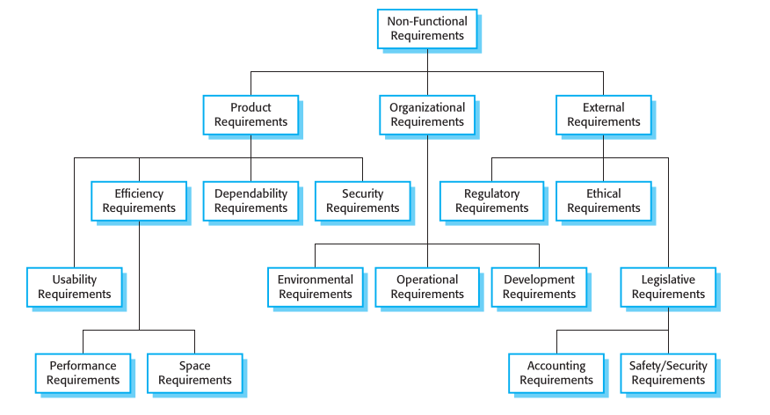
Types of non-functionalrequirement

Slide 12
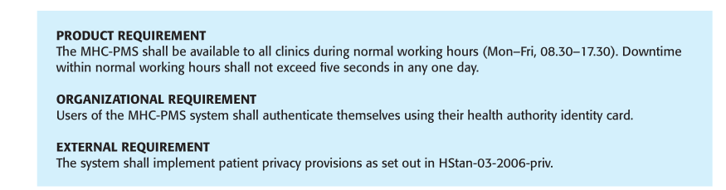
Eg of non-functional requirements in the MHC-PMS

Slide 13
you should write non-functional requirements quantitatively so that they can be objectively tested
Non-functional requirements often conflict and interact with other functional or non-functional requirements.

Slide 14
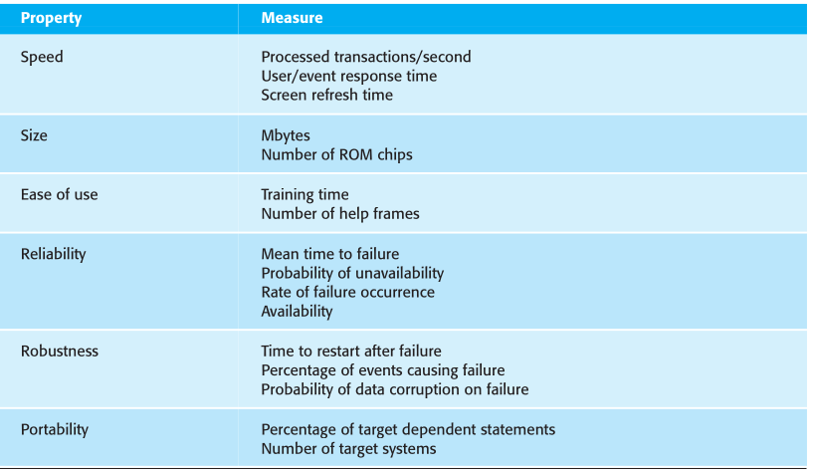
Metrics for specifying objectively testable non-functional requirements

Slide 15
software requirements document
The software requirements document (sometimes called the software requirements specification or SRS) is an official statement of what the system developers should implement.
SRS=User Requirements + System Requirement
Requirements documents are essential when an outside contractor is developing the software system.

Slide 16
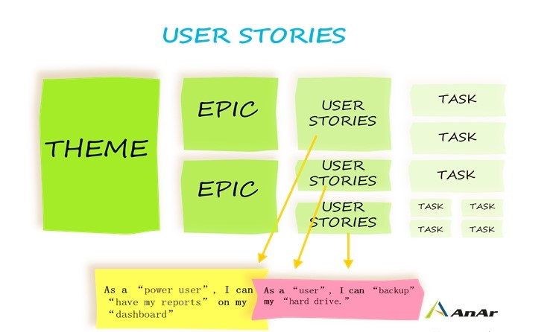
Agile Argue Otherwise(let’s talk)
Requirements change so rapidly
Effort is largely wasted
Incrementally write user stories on cards
User prioritizes requirements for implementation in the next increment

Slide 17
Take away
For business systems where requirements are unstable, Agile approach is a good one.

Slide 18
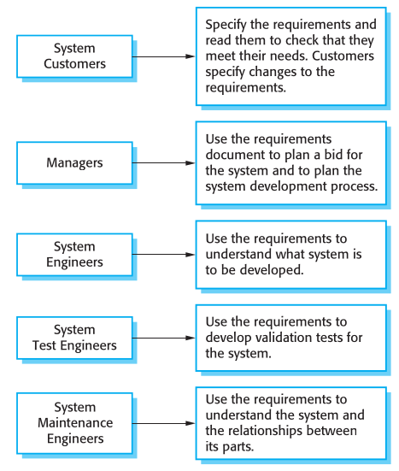
Users of a Requirements Document

Slide 19
The level of detail that you should include in a requirements document depends on the type of system that is being developed and the development process used. Eg:
Critical systems = detailed requirements
Outsourcing Development= detailed and precise
inhouse, iterative development= less detailed

Slide 20
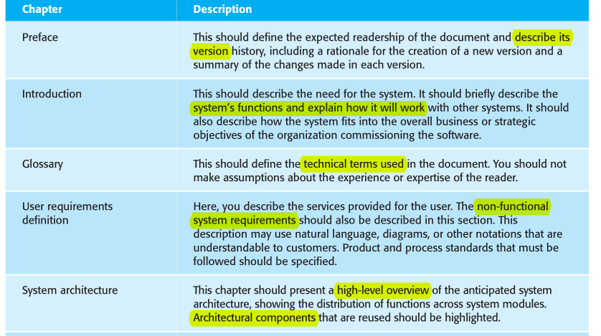
IEEE Standard for Requirements Documents (IEEE, 1998)

Slide 21
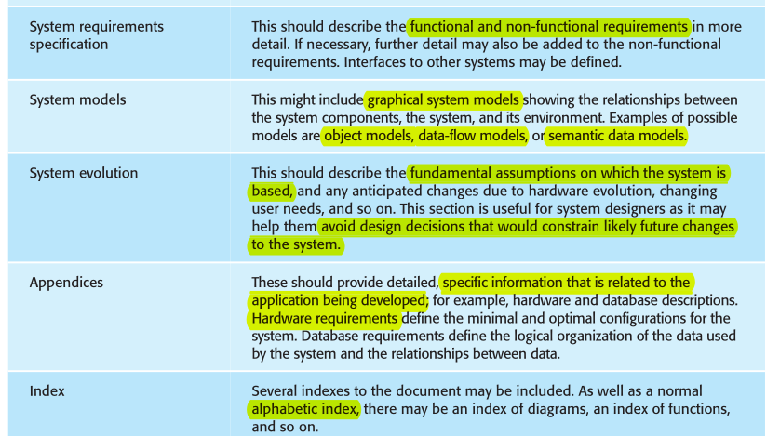

Slide 22
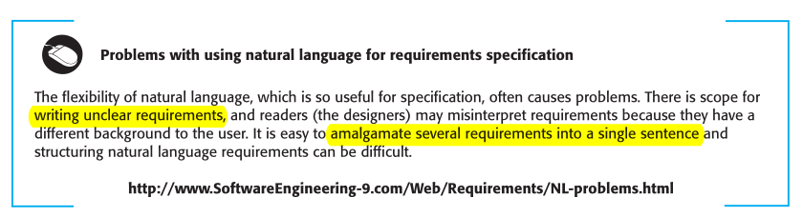
Problems with using natural language for requirements specification

Slide 23
Requirements specification

Slide 24
Requirements specification is the process of writing down the user and system requirements in a requirements document.
SRS=User Requirements + System Requirement

Slide 25
user requirements
The user requirements for a system should describe the functional and non-functional requirements so that they are understandable by system users who don’t have detailed technical knowledge.
user requirements = functional + non-functional - software jargon

Slide 26
Ideally, the user and system requirements should be clear, unambiguous, easy to understand, complete, and consistent.
you should not use software jargon, structured notations, or formal notations.
You should use natural language, with simple tables, forms, and intuitive diagrams.

Slide 27
System requirements
System requirements are expanded versions of the user requirements that are used by software engineers as the starting point for the system design
System requirements = user requirements + More Details + software jargon

Slide 28
System requirements
They add detail and explain how the user requirements should be provided by the system.
They may be used as part of the contract for the implementation
They should not be concerned with how the system should be designed or implemented.

Slide 29
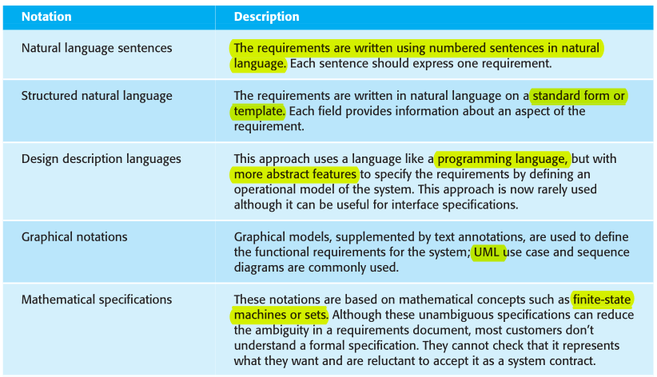
Ways of writing a system requirements specification

Slide 30
User requirements are almost always written in natural language supplemented by appropriate diagrams and tables in the requirements document.
System requirements may also be written in natural language but other notations based on forms, graphical system models, or mathematical system models can also be used.

Slide 31
Graphical models are most useful when you need to show how a state changes or when you need to describe a sequence of actions eg UML
Formal mathematical specifications are sometimes used to describe the requirements for safety- or security-critical systems, but are rarely used in other circumstances.

Slide 32
Natural language specification
Natural language has been used to write requirements for software since the beginning of software engineering.
It is expressive, intuitive, and universal.
It is also potentially vague, ambiguous, and its meaning depends on the background of the reader

Slide 33
To minimize misunderstandings when writing natural language requirement
Invent a standard format(eg 1 requirment : 1 sentence)
Use language consistently (eg ‘shall’ for must have)
Use text highlighting (bold, italic, or color) to pick out key parts of the requirement.
Do not assume that readers understand technical software engineering language(words like ‘architecture’ and ‘module’)
Whenever possible, you should try to associate a rationale with each user requirement(Why The Reuirement).

Slide 34
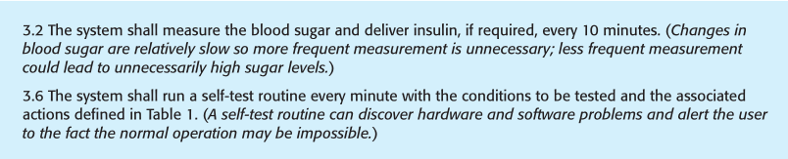
Example requirements for the insulin pump software system

Slide 35
Structured specifications
Structured natural language is a way of writing system requirements where the freedom of the requirements writer is limited and all requirements are written in a standard way.
This approach maintains most of the expressiveness and understandability of natural language but ensures that some uniformity is imposed on the specification.
Structured language notations use templates to specify system requirements.

Slide 36
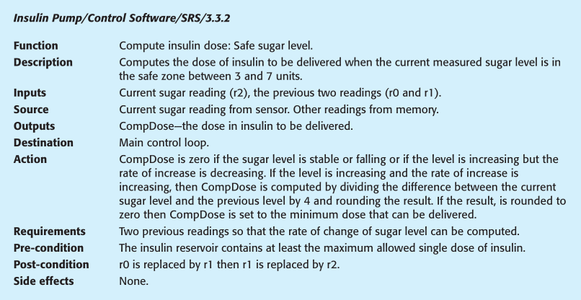
A structured specification of a requirement for an insulin pump

Slide 37
The Robertsons (Robertson and Robertson, 1999) Book recommend
that user requirements be initially written on cards, one requirement per card.
They suggest a number of fields on each card, such as the requirements rationale, the dependencies on other requirements, the source of the requirements, supporting materials

Slide 38
To Use standard form for specifying functional requirements included:
A description of the function or entity being specified.
A description of its inputs and where these come from.
A description of its outputs and where these go to.
Information that is needed for the computation or other entities in the system that are used (the ‘requires’ part).
A description of the action to be taken.
If a functional approach is used, a pre-condition setting out what must be true before the function is called, and a post-condition specifying what is true after the function is called.
A description of the side effects (if any) of the operation.

Slide 39
Using structured specifications removes some of the problems of natural language specification.
However, it is still sometimes difficult to write requirements in a clear and unambiguous way, particularly when complex computations
Solution: Tables are particularly useful (see next slide)

Slide 40
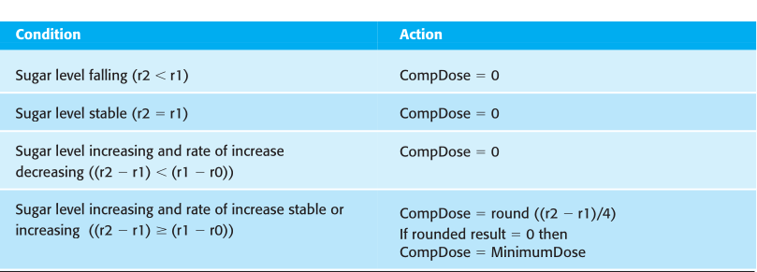
Tabular specification of computation for an insulin pump

Slide 41
Exercise Scenario: Landmark University Bread Industry Software Development
Landmark University's Bread Industry is looking to modernize its bread production process and supply by developing a software system to manage various aspects of the production, inventory, and sales.
Students are tasked with writing structured specifications for the software system(10 min).

Slide 42
THANKS
(More on “Requirements engineering processes........!!!)
Q&A

